Slide 1
Reactive REST APIs With Spring WebFlux
By: Asim Robinson

Slide 2
Reactive Programming: Intro
Reactive programming is programming with asynchronous data streams.
Reactive programming deals with developing non-blocking and event-driven applications built around asynchronous data streams.
Events, messages, calls, and even failures are going to be conveyed by a data stream.
With reactive programming, you observe these streams and react when a value is emitted.
Reactive Programming raises the level of abstraction so code in RP will likely be more concise.

Slide 3
Why reactive programming to build REST APIs?

Slide 4
Evolution of Applications
Legacy applications:
Monlithic
Not fully Distributed
Deployed in Application Server
Does not high scalability and high availability
Modern Applications:
Micro services
Distributed
Cloud Native
High scalability and high availability

Slide 5
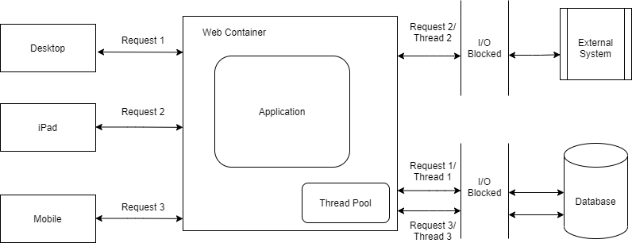
Issues with Traditional Approach
Traditional REST API request/response model

Slide 6
Issues with Traditional Approach
Blocking and Synchronous → The request thread will be waiting for any blocking I/O. Response will be send once I/O wait is over.
Thread per request → The web container uses a thread-per-request model. This limits the number of concurrent requests to handle.
No better utilization of system resources → The threads will be blocking for I/O and sitting idle.
No backpressure support → If there is a sudden surge of requests the server or client outages may happen.

Slide 7
Reactive Programming as a solution
Event/Message Driven→ The system will generate events or messages for any activity.
Support for backpressure → Pressure from one system handled on to the other system by applying back pressure to avoid denial of service.
Predictable application response time → Application response time is predictable under the load.
Better utilization of system resources → As the threads are asynchronous and non-blocking, the threads will not be hogged for the I/O.
With fewer threads, we could be able to support more user requests.
Move away from thread per request → Once the request is made, it creates an event with the server and the request thread will be released to handle other requests.

Slide 8
Spring Webflux

Slide 9
Spring Webflux
provides reactive, async, non-blocking programming support for web applications in an annotated Controller format similar to SpringMVC.
allow you to more efficiently leverage CPU and network resources
provide a more scalable architecture and a more responsive user experience.
The Spring Reactive Stack consists of:
Spring Boot 2+
Project Reactor
Spring WebFlux
Netty(as the default web server instead of Tomcat)
Spring Data Reactive Repositories
WebFlux provides support for two paradigms:
Annotation-based Spring Controllers(Similar to SpringMVC)
Functional Endpoints that allow for functional, fluent API style routing and handler functions

Slide 10
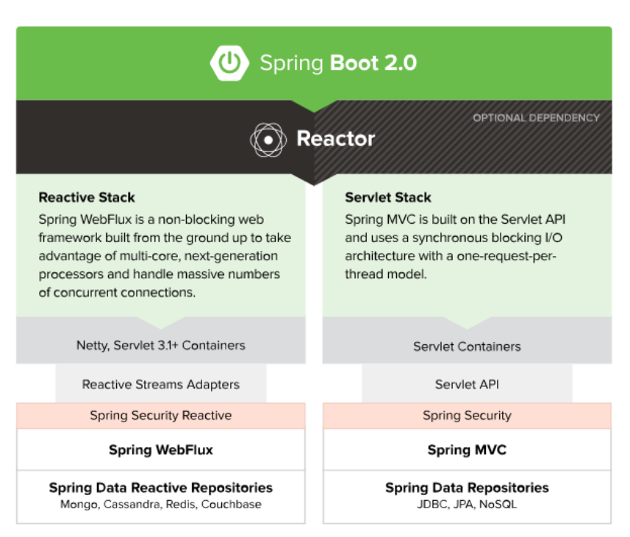
Spring Webflux

Slide 11
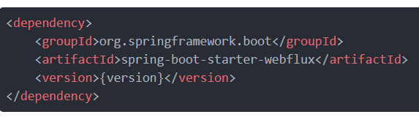
Spring Webflux Dependencies
With a plain Spring Boot project initialized through Spring Initializr, it's enough to add a single dependency:
For the applications using Gradle for dependency management, Spring WebFlux can be added in the application's build.gradle file:

Slide 12
Mono and Flux
In Spring WebFlux, the data returned from any operation is packed into a reactive stream.
There are two types that embody this approach and are the building blocks in WebFlux applications - Mono and Flux.
Mono is a stream which returns zero items or a single item (0..1), whereas Flux is a stream which returns zero or more items (0..N).
Mono is therefore used when you're expecting a single (or none) result, such as retrieving a unique user from the database.
whereas Flux is used when you're expecting multiple results or a collection of some sort.

Slide 13
Spring WebFlux Controller
To mark a class as a controller, we use the @RestController annotation on a class level.
Having Spring WebFlux and the Reactor Core dependencies in the class path will let Spring know that the @RestController is in fact a reactive component and add support for Mono and Flux.

Slide 14
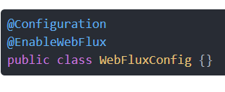
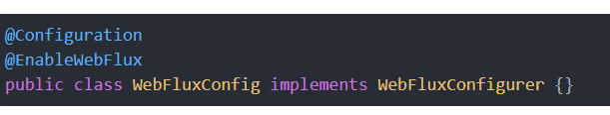
Spring WebFlux Configuration
The @Configuration and @EnableWebFlux annotations mark a class as a configuration class and Spring's bean management will register it:
To use or extend the existing WebFlux configuration API, you can extend the WebFluxConfigurer interface:

Slide 15
Demo Application

Slide 16
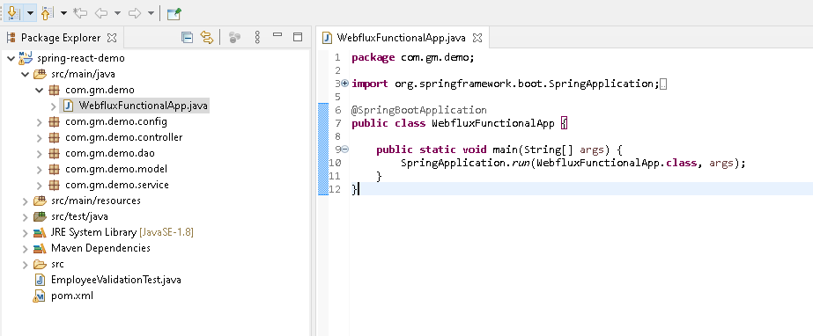
WebFluxFunctionalApp
Spring Application class:
The main() method uses Spring Boot’s SpringApplication.run() method to launch an application.

Slide 17
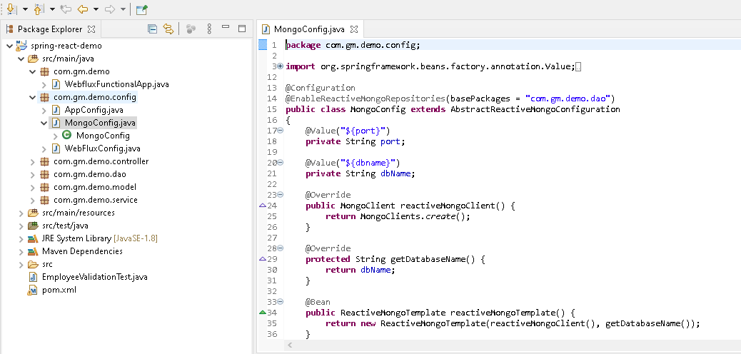
Mongo Configuration

Slide 18
Mongo Configuration
MongoConfig.java configures mongo database with the application.
@EnableReactiveMongoRepositories annotation carries the same attributes as the namespace element.
If no base package is configured, the infrastructure scans the package of the annotated configuration class.
In this file we are configuring values for port and database name for Mongo db.

Slide 19
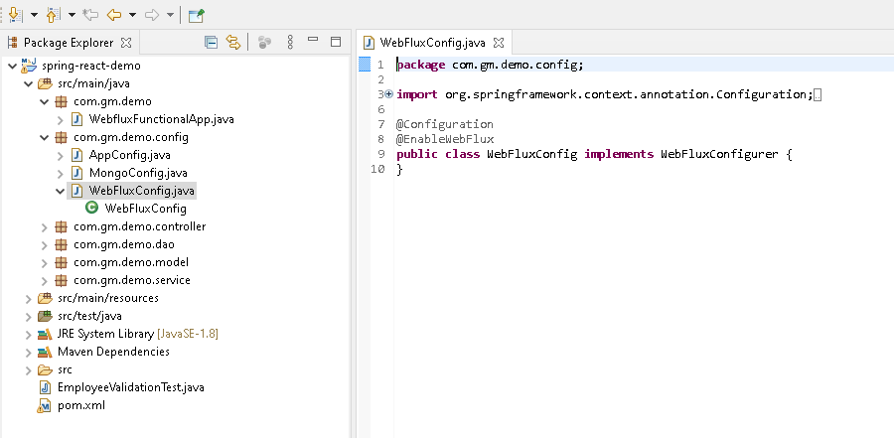
WebFlux Configuration

Slide 20
WebFlux Configuration
For Bootstrapping the Reactive Application, we won't use the standard @SpringBootApplication.
The @EnableWebFlux annotation enables the standard Spring Web Reactive configuration for the application.
It configure a Netty-based web server. Netty is an asynchronous NIO-based framework.

Slide 21
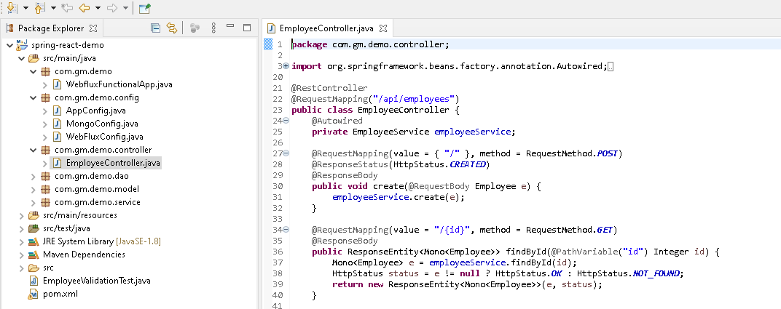
Employee Controller

Slide 22
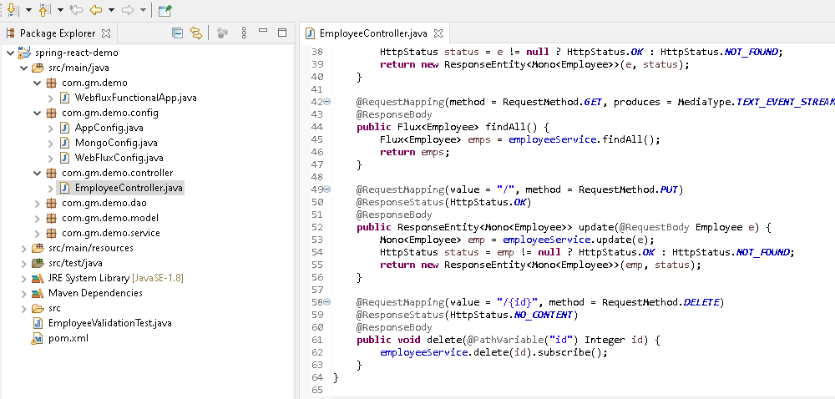
Employee Controller

Slide 23
Employee Controller
Employee controller that we have created here consists of four controller methods:
To get information of single employee by id: here we are using mono as a return type
To get information of all employees: here we are using flux as a return type.
Update employee information
Delete employee information.
Mono publisher here will be able to return 0or 1 element only.
Flux publisher Returns 0…N elements.
A Flux can be endless, meaning that it can keep emitting elements forever.
Also it can return a sequence of elements and then send a completion notification when it has returned all of its elements.

Slide 24
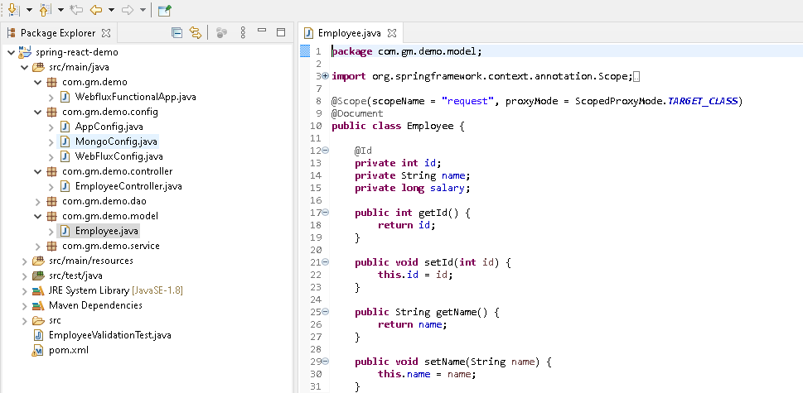
Employee Model

Slide 25
Employee Model
Employee model class define employee bean with id, name and salary as attributes.
We can define the bean with the request scope using the @Scope annotation
The scope of a bean defines the life cycle and visibility of that bean in the contexts we use it.
With proxy Mode attribute, spring creates a proxy to be injected as a dependency and instantiates the target bean when it is needed in a request.

Slide 26
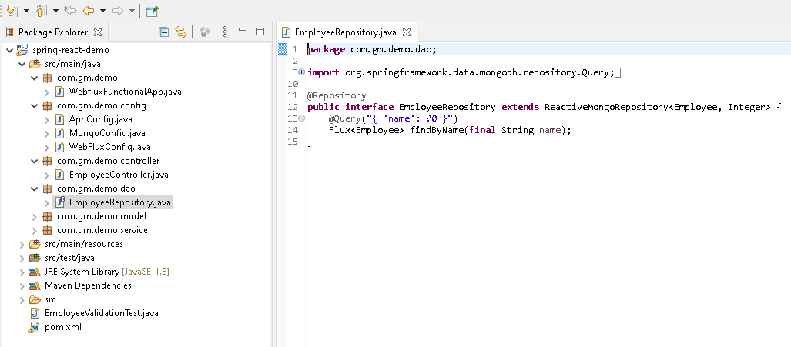
Employee Repository

Slide 27
Employee Repository
Employee repository here links employee model class with id type integer.
Employee repository class extends ReactiveMongoRepository.
Mongo specific Repository interface with reactive support.
This repository follows reactive paradigms and uses Project Reactor types which are built on top of Reactive Streams.
Interface for generic CRUD operations on a repository for a specific type.

Slide 28
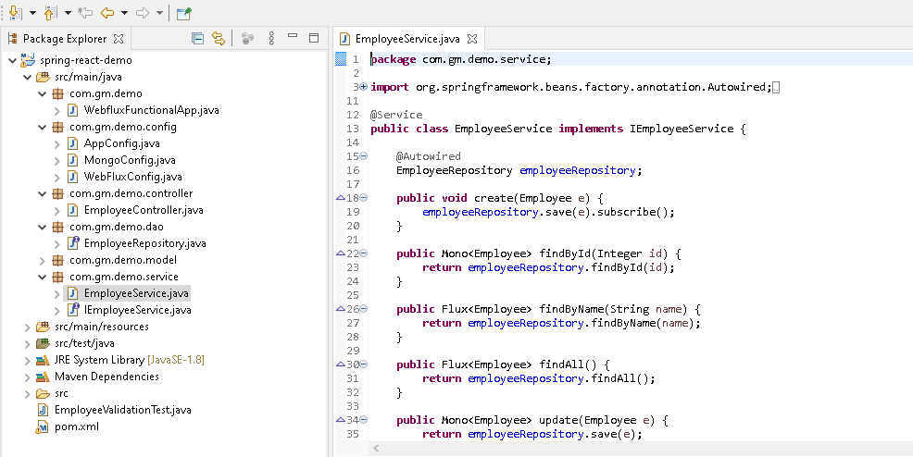
Employee Service

Slide 29
Thank You

